Slide 1
Scientific Forestry and the State

Slide 2
James Scott used the example of scientific forestry
Pioneered in the 18th century. The idea was to apply scientific principles to improve the productivity and efficiency of forests. Similar to what the government applies to ensure efficiency
“Efficiency” was used to mean “revenue yield of timber” per acre of land.

Slide 3
How did it work?
Underbrush would be cleared
Number of species would be reduced ( you would just plant what you intended to sell)
Trees planted in uniform rows (allowed for easy access for weeding, watering and harvesting)
Since trees were planted at a set time, long-term contracts could be negotiated for sale (maybe even decades in advance).

Slide 4

Natural Forest

Slide 5
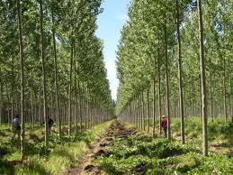
Scientifically Managed Forest

Slide 6
Different ways of regarding forest
OLD
NEW
Forest as habitat
“Nature”
Animals
Trees
Food
Flora (grasses, flowers, lichens)
Forest as commodity
“Natural Resources”
Pests
Timber
Crops
Weeds (plants that could not be sold)

Slide 7
Things which “revenue yield of timber” did not recognize
Foliage, which was used to thatch roofs
Barks and roots, which were used for medicine
Fruits and berries used for food
Wild game
Sacred sites in the forest

Slide 8
Results: In the short term, good!
Productivity went up enormously.
Revenue and sales could be managed more directly

Slide 9
Results: in the long term, bad!
By the second or third generation, problems began to materialize. Complex eco-system.
Clearing underbrush kept rich top soil from developing
With all the same species, more susceptibility to disease.
Less resilient to natural disasters, like windstorms and fires.
New terms: “Waldsterben” or “forest death”

Slide 10
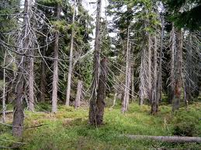
“Waldsterben”

Slide 11
How this relates to the state
Utopia: This is a perfect society where are current problems are gone. It is used rhetorically to illustrate what is wrong with our current world.

Slide 12
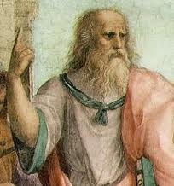
PLATO:Lack of wise rulers is the problem
Philosopher kings are the solution
To reconcile less wise citizens to being ruled by the philosophers, children to be raised by the state.
Noble lie is needed for the transition

Slide 13
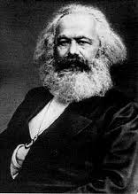
MARX: Economic Exploitation is the problem
Solution is the end of capitalism
Rule of the “proletariat”
Overthrow of the bourgeoisie is required to usher in the perfect era

Slide 14
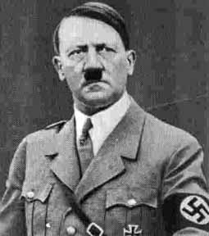
NAZIS: Non-Aryan races are the problem
Solution is the subjugation, and in some cases extermination of other races (such as the Jews)
This allows for the supremacy of the Aryan race

